Slide 1
Data Hub is an Professional Services packaged offer for enterprises who need to increase data utilization and reduce data time to value
Data Hub
In a way that
Unlike many other data lake solutions,
DataHub
Collects and organizes enterprise data in distributed and isolated data lakes
Discovers, catalogs, and shares data across business units and regions
Accelerates analytic and machine learning application development
Follows best practices of security, architecture, and development
Allows true data market place inside the enterprise
Focuses on increasing data utilization and data time to value,
by encouraging secure data sharing across business units,
and taking advantages of and integrate with rich choices of AWS services and partners

Slide 2
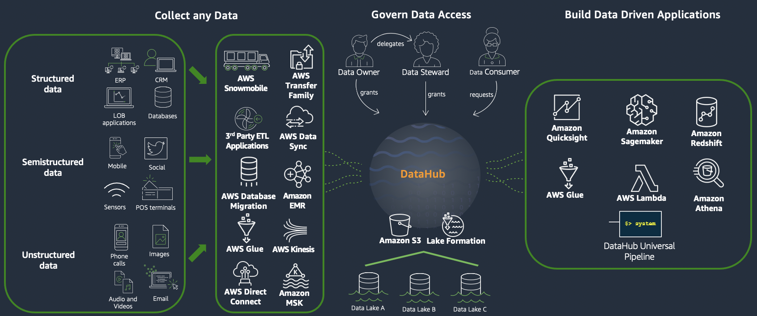
DataHub solves enterprise data problems through Distributed Data Lakes, Centralized Catalog, and Development Accelerators

Slide 3

Data Analysts, Data Engineers, Data Stewards, and Data Scientists use 24 functionalities¹ of DataHub to accomplish their tasks
Data Owners
Data Consumers/ Analysts
Store data securely and in a governed way following best practices reinforced by DataHub
Catalog the contents curated by the analyst and make the contents available to the whole enterprise.
Grant & remove access to the data
Control the access to the data to the appropriate granularity
Track the usages of the data
Create the data profiling of the data
Share or delegate data governance to data stewards at data set level.
Browse and search data in the enterprise catalog
Identify the owner of datasets available in the enterprise
Preview a specific dataset
Review the data quality of a dataset
Request access to the data
Access the data using the correct access rights reinforced by DataHub using EC2, Notebook, Cloud 9, or other AWS services
Query the data they have access to using Athena
Run ETL / SQL processings against the data respecting the access rights backed up by CI/CD pipeline using standard technology such as Git.
Data Stewards
Govern the data governance on behalf of its customers
¹The list of functionalities as of 8 September 2020

Slide 4
Data Analysts, Data Engineers, Data Stewards, and Data Scientists use 24 functionalities¹ of DataHub to accomplish their tasks
Data Scientists
Devops / Data Engineers
Can do all tasks listed in the « Data Analyst » section
Explore data using notebooks configured with the right access and backed up by git.
Create machine learning pipelines for data preparation & training with DataHub taking care of the infrastructure setups.
Create machine learning pipelines for batch & real time prediction with DataHub taking care of the infrastructure setups aund automation
Monitor machine learning pipelines for performance drift with DataHub taking care of the infrastructure setups and automation
Deploy DataHub as enterprise data marketplace.
Create the data hub organizations and environments respecting the enterprise account structures.
Monitor the use of data and the processes related to DataHub .
Adapt DataHub to new functionalities required by enterprise.
¹The list of functionalities as of September 2020

